Slide 1
Negotiating a Well-Being Portfolio

Slide 2
Agenda
A frame for strategy: Urgent needs and vital conditions
Characterizing our region’s current strategy: How are we allocating our efforts now?
Characterizing our desired future strategy for the region: How do we want to allocate our efforts to close the gap and achieve our vision?
So what? Now what?: Implications for our group and next steps
2

Slide 3
A Sobering Portrait of Unfolding Trends
In most regions across the United States…
Population is growing larger and aging rapidly
Entrenched inequities exist among sub-groups
Insurance coverage has expanded, but is not yet universal [and may now be poised to erode]
Health care quality is mediocre, with limited capacity for primary care
Slow recovery from economic recession coupled with health costs are pulling people into debt and unemployment
High levels of vulnerability exist from risky behaviors, hazardous environments, crime, and poverty
There is a mounting burden of chronic disease and lost productivity
Cost of personal health care is rising ($2.4T in 2015, on course to spend $4.5T in 2040; $82T cumulatively)
3
Notes:
Insert your value proposition or challenge here.
TALKING POINTS (if you use this more general slide):
In the average American town, we are facing a variety of challenges leading to poor health. (Slowly read through the list)
In what ways is our region experiencing these same challenges?
In what ways is our region different? (Differences might include declining population, influx of young people for tech jobs, etc.).
Many regions are making efforts to improve these conditions. They each have an implicit – if not a stated – strategy for doing so, the sum of interventions being enacted across the region.
Today we are going to explore and assess the strategy that is currently in place for our region.

Slide 4
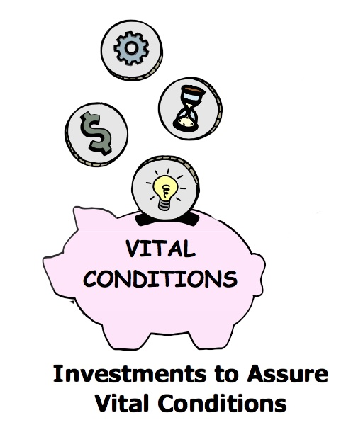
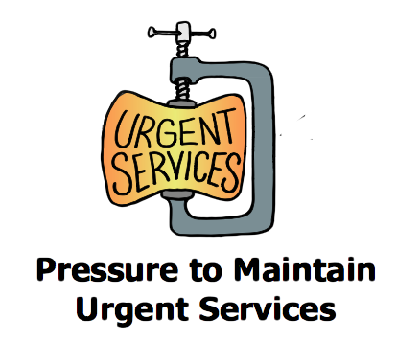
Are we Shifting the Burden of Health and Well-Being?
o
Relying
o
Caring
Enhancing
Acute care for illness or injury
Addiction treatment and recovery
Criminal justice, emergency response
Environmental cleanup
Unemployment, income assistance
Homeless services
Basic needs for health and safety
Lifelong learning
Meaningful work and wealth
Humane housing
Stable natural environment
Reliable transportation
o
o = opposite
= delay
4
Notes:
TALKING POINTS:
But first, let’s get a handle on the types of things that communities are doing:
But first, let’s get a handle on the types of things that communities are doing:
In many regions there are grave threats to well-being. And these regions are under intense pressure to maintain urgent services: acute care for illness or injury, addiction treatment and recovery, criminal justice, emergency response, environmental cleanup, unemployment, income assistance, and homeless services.
They have developed a robust set of services to address those urgent needs, CARING for those that need help. An alternative is to invest in vital conditions, like: basic needs for health and safety, lifelong learning, meaningful work and wealth, humane housing, stable natural environment, and reliable transportation. These investments will enhance well-being by removing threats to it.
Unfortunately, when we devote too many resources to urgent services, there is seldom enough left for investments in vital conditions. And regions can get trapped in RELYING on these urgent services and never properly addressing the vital conditions that can lead to greater health and well-being in the long-term.
In this next exercise, we will explore our region’s current emphasis and propose a better way.
(Please note that this is a causal map, a tool of systems thinking. It also represents a systems archetype called “shifting the burden”—focusing on quick fixes to the extent that it becomes harder to implement the fundamental solution. Focusing on urgent needs can prevent regions from addressing the vital conditions that will create health and well-being. You can read more about systems thinking at www.thesystemsthinker.com)

Slide 5
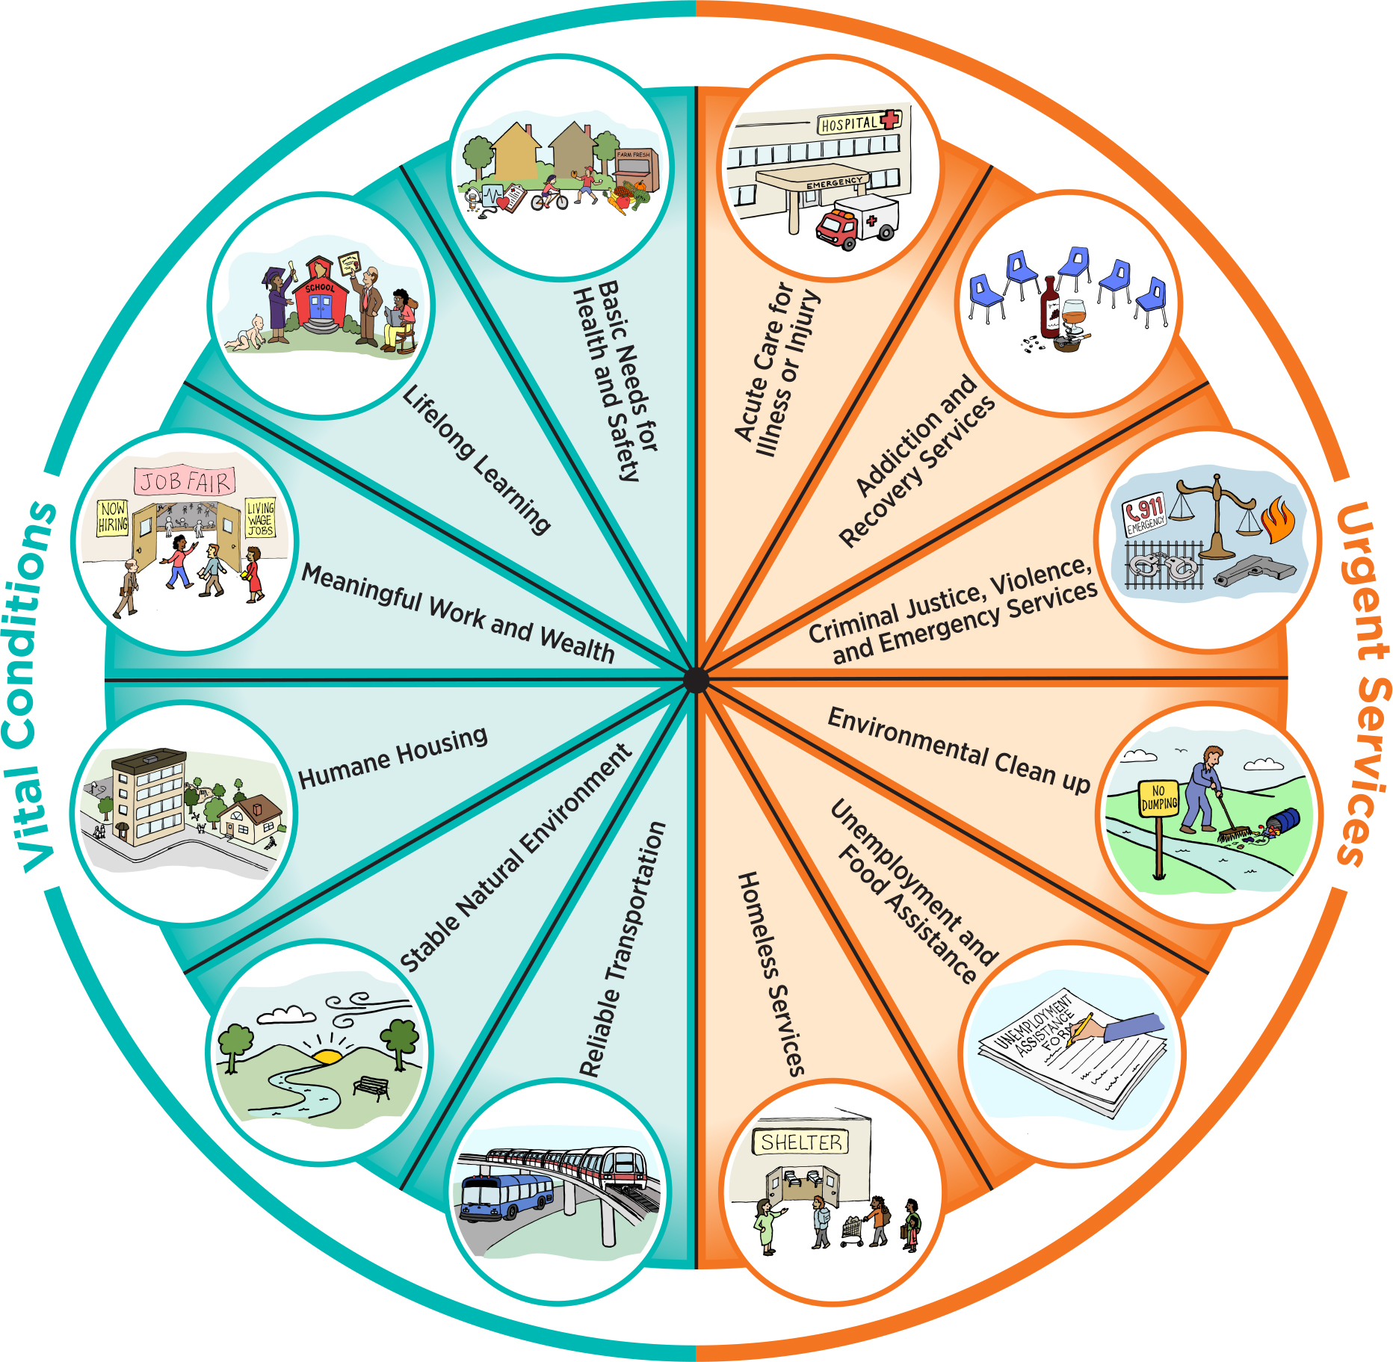
A Practical Portfolio
Properties of places and institutions that all people need regularly to be healthy and prevent harms to well-being
Services that anyone under adversity may need temporarily to regain or restore well-being
VITAL CONDITIONS (N=6)
Basic needs for health and safety
Lifelong learning
Meaningful work and wealth
Humane housing
Stable natural environment
Reliable transportation
URGENT SERVICES (N=6)
Acute care for illness or injury
Addiction treatment and recovery
Criminal justice, emergency response
Environmental cleanup
Unemployment, income assistance
Homeless services
5
Notes:
TALKING POINTS:
There is a copy of this same chart, with vital conditions on the left and urgent services on the right, at each of your tables,
These are the same vital conditions and urgent services represented in the map on the last slide, also listed here.

Slide 6
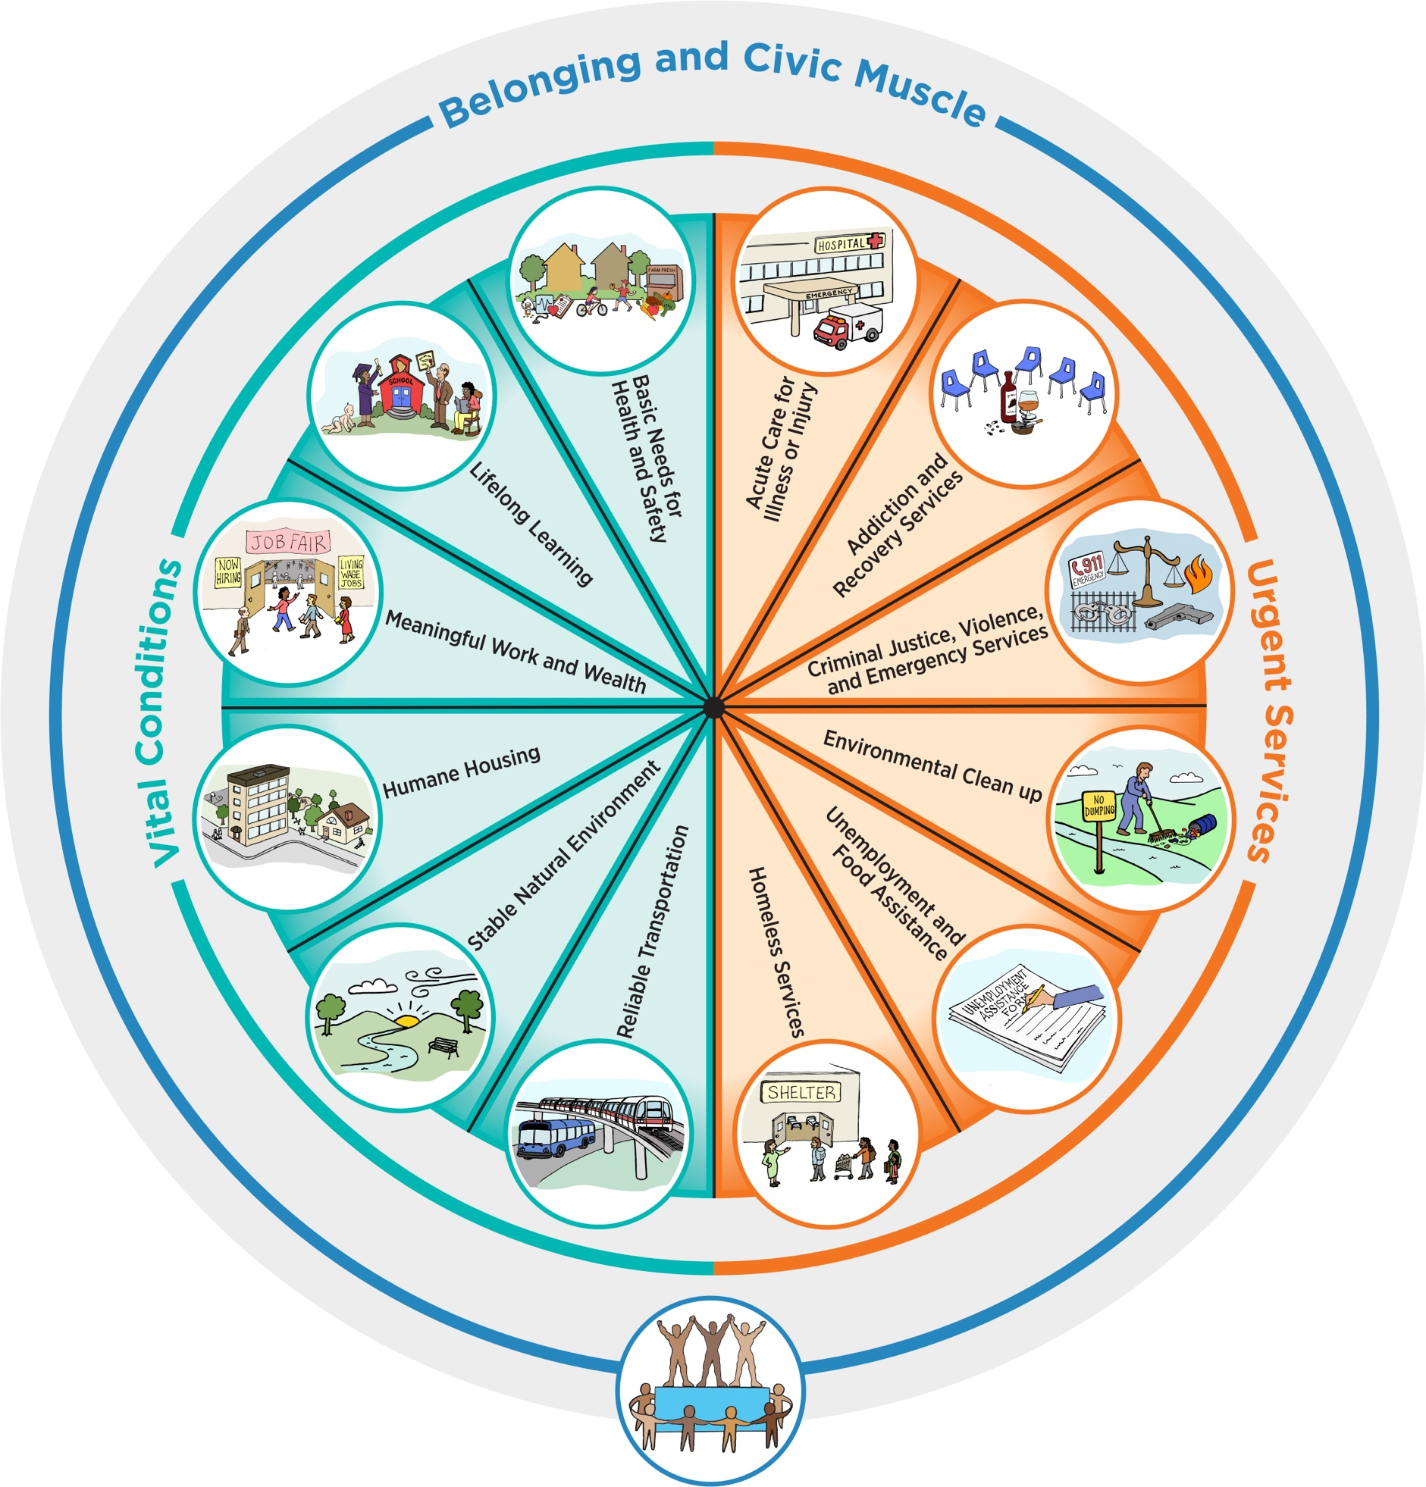
A Practical Portfolio
Belonging and Civic Muscle:
Special capacities of people and institutions that convey to all a sense of belonging and power to
influence the policies, practices, and programs that shape our world
6
Notes:
TALKING POINTS:
Additionally, the vital conditions and urgent services are supported by development of belonging and civic muscle, another option for investment. We define belonging and civic muscle as special capacities of people and institutions that convey to all a sense of belonging and power to influence the policies, practices, and programs that shape our world.
Examples of investments in belonging and civic muscle include:
Seattle Foundation’s Civic Commons, a new regional infrastructure to unite more community voices in decision making. One specific venture of theirs is called You Belong Here, which is designed to build a leadership ethos that crosses traditional networks,
The Women’s March in which citizens convened and mobilized to Washington, DC and various other metropolitan areas to express their displeasure at the recent election, and
Black Lives Matter whose mission is to “build local power and to intervene in violence inflicted on Black communities by the state and vigilantes”.

Slide 7
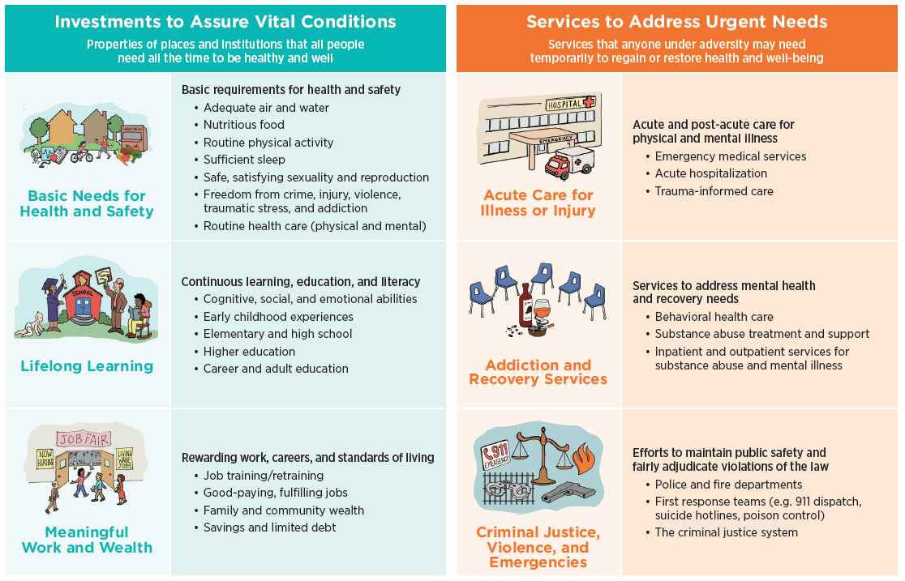
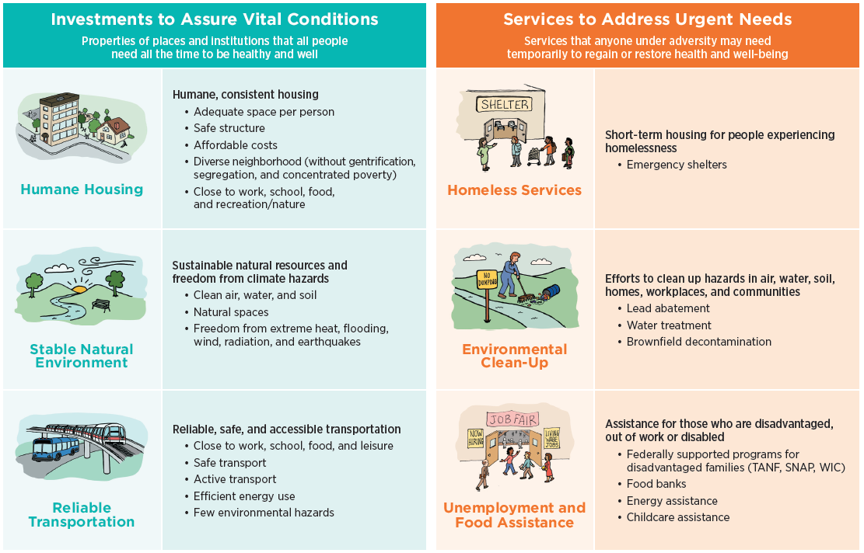
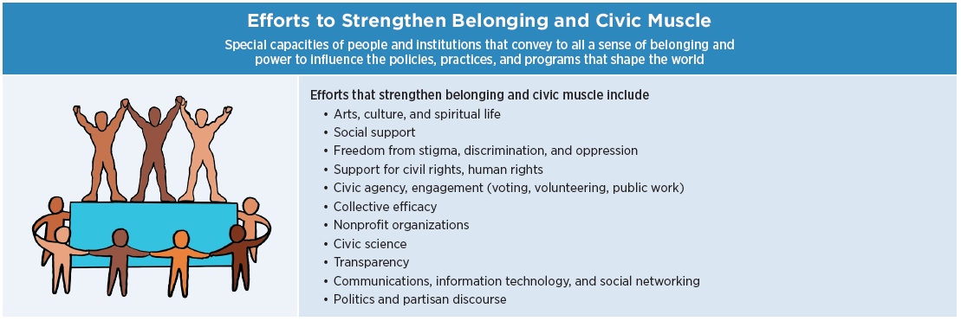
Working Definitions
Take 2 minutes to review these definitions.
Any questions?
7
Notes:
TALKING POINTS:
Descriptions are provided for each of the pieces of the pie.
Please take a moment to review them.
Let me know if you have any questions.

Slide 8
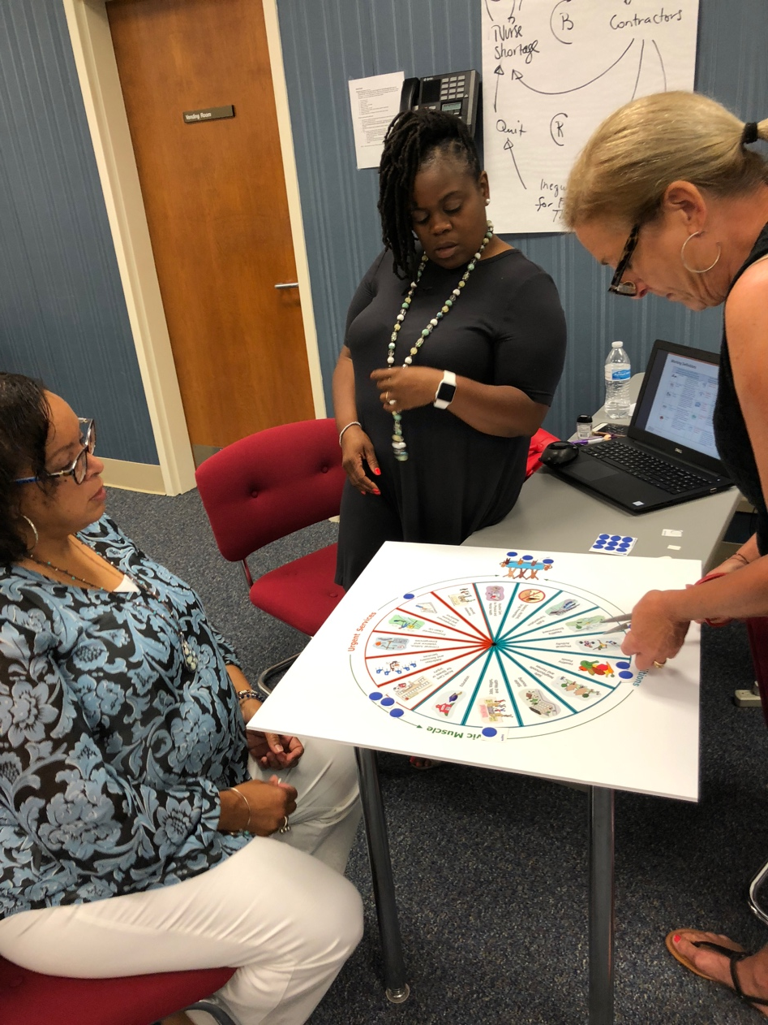
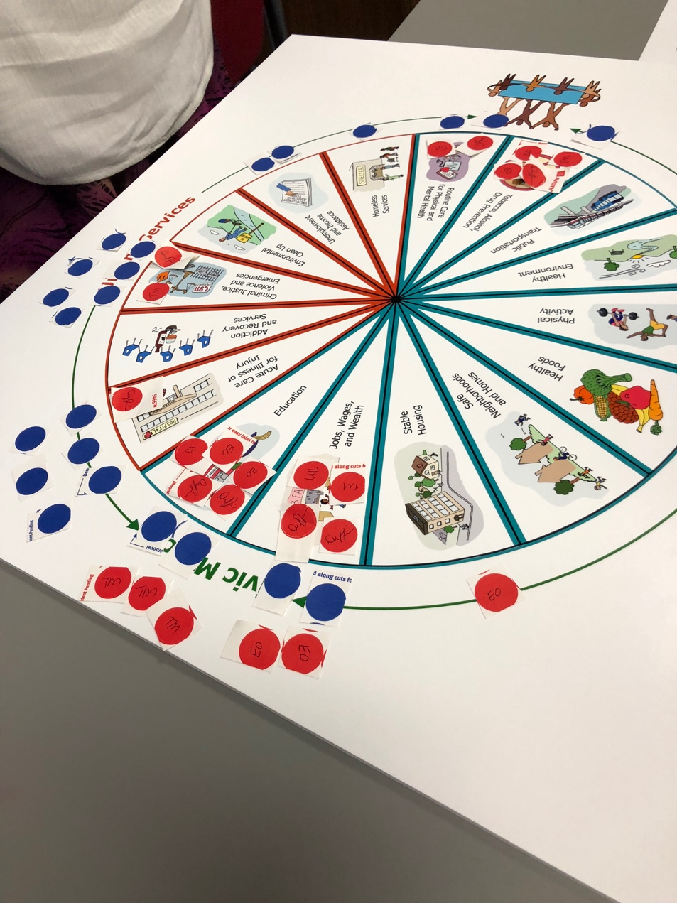
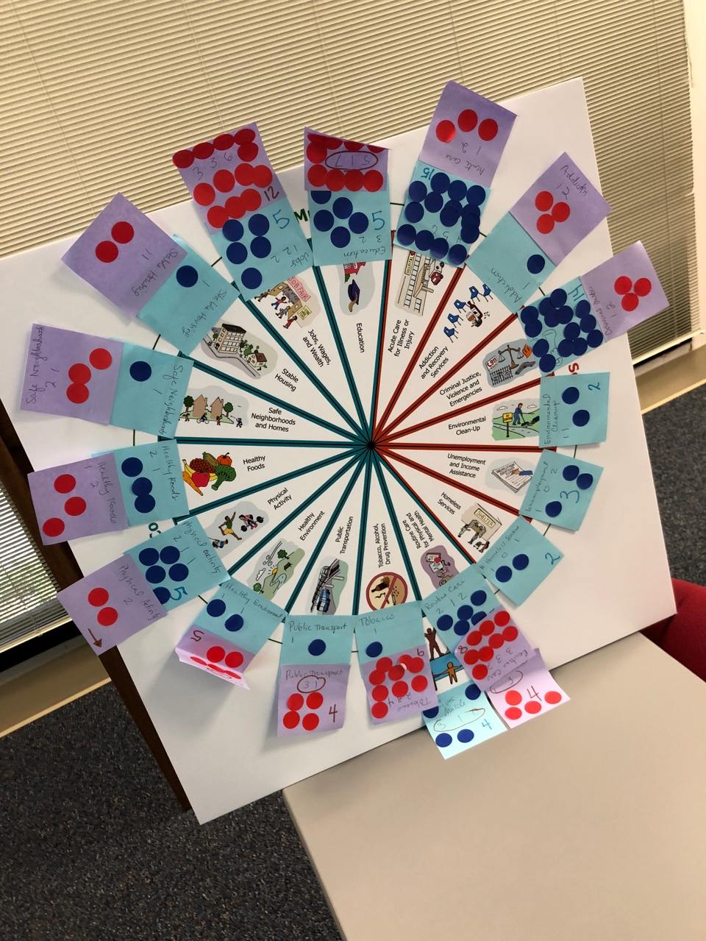
Our Goal
Notes:
TALKING POINTS:
We are going to break into small groups and work together to figure out where we are spending resources NOW.
Then we will compare that to where we think we should be spending resources.
Finally, we (the facilitators) will consolidate the group’s work into a shared map and we’ll discuss.
Now let me break it down into steps for you.

Slide 9
Part 1: Identify CURRENT activities in your region.
Consider where resources in your region are currently directed.
As a group use blue sticky dots to represent the emphasis of current activities in your region.
Place dots but don’t stick them until discussion is complete.
Discuss allocation and rearrange until there is consensus.
9
Notes:
TALKING POINTS:
In the first part of this exercise, we will identify the current priorities in our region by thinking about which portfolio options we are actually pursuing right now. In your small groups, work together to allocate 20 blue dots, according to the level of the resources expended on them in the region.
Resources include money, in-kind, and volunteer time
Consider efforts outside your realm of control, including things done by other organizations
Assume that you are spending some base level in all categories and use the dots to characterize relative resources above and beyond the baseline

Slide 10
Part 2: Identify priorities for your region’s FUTURE strategy
Evenly split your red dots among each team member and have them write their initials on them.
Each person should place (but not stick) their dots next to the options that they believe SHOULD have resources.
Once done, the group may negotiate with each other to shift dots, though only the person who placed a dot may move it.
Once you are done, stick the dots on permanently.
10
Notes:
TALKING POINTS:
In the second part of the exercise, we will identify the future priorities in the region by thinking about where resources should be directed to achieve our vision for the region. Using the same pie chart and working together in your small groups, allocate 20 red dots, according to how you believe resources should be directed.
Resources include money, in-kind, and volunteer time
Consider efforts outside your realm of control, including things done by other organizations
Assume that you are spending some base level in all categories and use the dots to characterize relative resources

Slide 11
15 min
11
Notes:
INSTRUCTIONS FOR FACILITATORS:
You may need more than 15 minutes for this break depending on the amount of help you have and the number of teams.
Invite participants to do a gallery walk to look at the results of other teams.
Use this breaktime to summarize all the dots on the poster at the front of the room. One way to do this:
Record the number of red and blue dots on each poster for each group (this can be helpful to have handy during the debrief, so you are encouraged to use red and blue markers and record the individual numbers and the totals on the pie chart so you can see it during the debrief)
Stick the appropriate number of blue and then red stickies on each category to represent the total from all working groups.
Don’t forget belonging and civic muscle.
Identify the following in some way:
Items for which there was a big reduction in the number of stickies from blue to red
Items for which there was a big increase in number of stickies from blue to red
Items for which there were major differences across teams in the number of blue or red stickies
Make note of whether there were major changes that took place between the blue and the red round.

Slide 12
Straw Poll
Does the composite new strategy directionally reflect what we want to do to close the gap between our vision and reality?
For those who say no, what would need to change?
For those who think it is directionally correct but could be improved, how would you change it?
12
Notes:
FACILITATOR INSTRUCTIONS:
Conduct a straw poll to gauge the group’s reaction to the exercise.

Slide 13
Debrief
What similarities and differences did you see between groups?
Any observations about the aggregate result?
What are the priority areas for future investment?
What is the logic for reallocating resources? Continuing to invest resources?
What implications does this suggest for us as regional stewards?
13
Notes:
FACILITATOR INSTRUCTIONS:
This discussion should be led by the facilitator, but the goal is to elicit responses from the group.
We tend to find that
Overall CURRENT spending emphasizes urgent services and DESIRED spending emphasizes vital conditions—which is a strong point you will want to elicit from the group.
There are a small number of things that are currently being focused on and they are usually urgent services.
There are a small number of things that the group would like to focus on in the future.
Sometimes there are connections between things they want to reduce and what they want to increase (i.e., increasing jobs will lead to a reduction in the need for homeless services)—it is useful to point this out.
Sometimes they may desire to get rid of something, but not be increasing anything to help do that—also worth pointing out.
Make sure to reflect on what this means for the group moving forward
Do they need to invite new people to the table?
Do they need to find new funding sources?
Do they need to build new skills in the community to address new areas?

Slide 14
Implications
This conversation gives us direction in moving forward
Implications for this group, including:
New partnerships
Timing
Financial support
Next steps
Thank you!
14
Notes:
FACILITATOR INSTRUCTIONS:
We find that it most effective to have leadership present what they have heard as the implications and next steps for the group. We typically find that this exercise prompts the following kinds of implications:
New partnerships: In order to redirect energies to new programs and initiatives, you may find that you need to bring new partners to the table.
Timing: This exercise may reveal that you should be directing resources toward a number of different portfolio options. In that case, there may be questions about timing: in what order should you pursue these new strategy options?
Financial support: In addition to timing, you will want to consider how you will fund the new work you are proposing in the region
There may be other questions or avenues for further exploration that you discover over the course of this exercise, and you should also name those here.
You do not need to answer these questions within the confines of this exercise, but it is valuable to end the exercise by identifying the next steps that you will need to take together.

